Slide 1
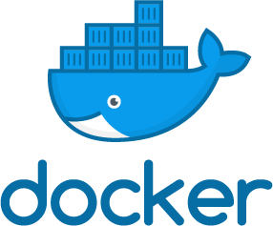
Docker BWI Innovation Talk
Dr. Timm Heuss March 2018
Docker is one of the most interesting and promising paradigm shifts of the last years. In this talk, I will introduce Docker shortly and present universal lessons learned after two years of practical use. It becomes clear that not only source code needs to be refactored, but also infrastructure, processes and people's mindsets. Once embraced, Docker allows for faster ramp-up times and is an enabler for modern software development.
These slides are available online:
https://github.com/heussd/docker-bwi-innovation-talk

Slide 2

Agenda
These slides are available online:
Introduction to Docker
Why the Hype?
Lessons learned from two years of practical use
Interesting readings and tools
What‘s next?
https://github.com/heussd/docker-bwi-innovation-talk

Slide 3
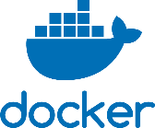
Introduction to Docker
BSD Jails
Solaris Zones
Linux Containers
1.0
2000
2005
2010
2015
2017
Shipping software in virtual images with all runtime dependencies
The idea is not really new
What makes Docker special:
Docker focuses on streamlined developer workflows
Cross-platform runtime environment
Open Container Initiative (OCI) Standard
Related approaches: rkt (“Rocket”), Facebook Tupperware, …

Slide 4
Introduction to Docker
VirtualBox?
Shipping software in virtual images with all runtime dependencies
VMware?
My App 1
My App 2
Guest Userland
Guest Userland
Manual Installation
Not
really needed
Guest Kernel
Guest Kernel
Infrastructure
Infrastructure
Virtual Machine Engine
Host OS
Infrastructure

Slide 5

Introduction to Docker
Shipping software in virtual images with all runtime dependencies
docker-compose as simple Docker orchestrator
Instance of an Image, Docker Container
Container
Container
My App 1
My App 2
Docker Image, a
dockerfile describes all layers in a machine readable way
App-specific dependency
Dependency
Dependency
Baseline functionality of every image
Base Image
Base Image
Docker Engine
Linux, Windows 10 or macOS (>= Yosemite)
Host OS
Infrastructure

Slide 6
Dockerfile + docker-compose.yml
services:
app1:
build: myapp1/
image: java-sth
ports: 8080
app2:
build: myapp2/
image: bash-tool
importantdb:
image: postgres:latest
latest… what exactly? We’ll see later: Lesson 2: Meanings of “latest”
docker-compose
dockerfile
dockerfile
ADD myapp1.war /usr/local/tomcat/webapps
Container
Container
CMD /exec.sh ADD myapp2.sh /exec.sh
My App 1
My App 2
Dependency
Dependency
RUN apt install –y curl
FROM tomcat:alpine
Base Image
Base Image
FROM ubuntu:17.10
Docker Engine
alpine is a special size-reduced baseline
Version
Host OS
Infrastructure

Slide 7
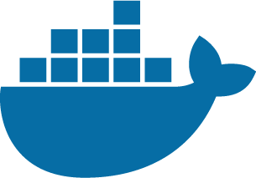
Dockerfile + docker-compose.yml
Docker Hub
services:
app1:
build: myapp1/
image: java-sth
ports: 8080
app2:
build: myapp2/
image: bash-tool
importantdb:
image: postgres:latest
docker-compose
Dockerfile
Dockerfile
ADD myapp1.war /usr/local/tomcat/
Container
Container
CMD /exec.sh ADD myapp2.sh /exec.sh
My App 1
My App 2
Dependency
Dependency
RUN apt install –y curl
FROM tomcat:alpine
Base Image
Base Image
FROM ubuntu:17.10
Docker Engine
See also: Lesson 3: Docker & Security - it’s complicated
Host OS
Infrastructure

Slide 8
Dockerfile + docker-compose.yml
Docker Hub
services:
app1:
build: myapp1/
image: java-sth
ports: 8080
app2:
build: myapp2/
image: bash-tool
importantdb:
image: postgres:latest
docker-compose
Dockerfile
Dockerfile
ADD myapp1.war /usr/local/tomcat/
Container
Container
CMD /exec.sh ADD myapp2.sh /exec.sh
My App 1
My App 2
Dependency
Dependency
RUN apt install –y curl
FROM tomcat:alpine
Base Image
Base Image
FROM local:5000/ubuntu:17.10
Docker Engine
See also: Lesson 3: Docker & Security - it’s complicated
Host OS
Use a local Docker registry by adding prefix to the image names
Infrastructure

Slide 9
Docker in a Nutshell
Shipping software in virtual images with all runtime dependencies
Layered, caching filesystem that transparently reuses previous build steps / other images
Reproducible, machine-readable instructions to produce images (dockerfile), ready for Continuous Integration and Continuous Delivery
Standardised specification of networks, ports, external files and the interplay of several virtual images (docker-compose)
My App 1
My App 2
Dependency
Dependency
Base Image
Base Image
Docker Engine
Host OS
Infrastructure

Slide 10
Why the Hype?
docker run -e MYSQL_ROOT_PASSWORD=my-secret-pw mysql:5.7.21
Downloads, installs, configures and runs MYSQL 5.7.21

Slide 11
Why the Hype?
Minimise Lead & Ramp Up Times | Developers define their own infrastructure (“as code”), seamless integration of third-party software and distribution channels, build automation can build, package, roll-out and execute the entire software stack
Self-Contained-Services / Microservices | Docker images are self-contained or clearly define their dependencies to external databases and resources
„Cloud is the new normal“ | Docker is cloud native, Docker images are infrastructure agnostic

Slide 12
Why the Hype?
Minimise Lead & Ramp Up Times | Developers define their own infrastructure (“as code”), seamless integration of third-party software and distribution channels, build automation can build, package, roll-out and execute the entire software stack
Self-Contained-Services / Microservices | Docker images are self-contained or clearly define their dependencies to external databases and resources
„Cloud is the new normal“ | Docker is cloud native, Docker images are infrastructure agnostic

Slide 13
Why the Hype?
Developers are payed for:
Developers are not payed for:
Developing software
Re-inventing the wheel
Configure IDE
Manage and download dependencies
Package software
Execute unit tests and integration tests
Distributing software packages
Continuously monitor source control, build
Determine the common build status (“Are we green?”)
Document operational environment
Install, configure and start-up operational environment
Install, configure and start-up runtime dependency software such as Databases
Prepare, package, configure, distribute and install releases
Commodities
Build Management
Continuous Integration
Docker helps significantly in automating this
Containers
Even if you don’t use Docker - your competitor will!
Continuous Delivery

Slide 14
Lessons learned from two years of Docker
Lesson 1: Understand the tools you use
Lesson 2: Meanings of “latest”
Lesson 3: Docker & Security – it’s complicated
Lesson 4: Docker is not done yet
Lesson 5: Have a Docker-ready architecture
Lesson 6: Docker, the MVP enabler
Lesson 7: Use Build Infrastructure
Lesson 8: Streamline Developer’s Workflow
Lesson 9: Rethink Infrastructure
Lesson 10: Refactor mind sets
Docker Basics
Software- Architecture
Processes
Infrastructure
Mindsets

Slide 15
Lesson 1: Understand the tools you use
Don’t do this:
RUN APT UPDATE RUN APT INSTALL –y openjdk, make
RUN cd /somepath RUN make
The art of writing a Dockerfile
Understand Docker
Follow Docker best practices [1]
dockerfile: Readability and duplication over fanciness
Don’t use docker commit
Question everything (including best practices)
Do not solve future problems
Cachable, readable
RUN APT UPDATE && \ APT INSTALL –y openjdk, make
RUN cd /somepath && \ make
Cachable, readable, image size is minimised
ENV BUILD_DEPS make ENV RUN_DEPS openjdk
RUN APT UPDATE && \ DEBIAN_FRONTEND=noninteractive APT \ INSTALL -y --no-install-recommends \ $BUILD_DEPS, $RUN_DEPS
RUN cd /somepath && \ make
RUN APT remove –y $BUILD_DEPS && \ rm -rf /var/lib/apt/lists/
[1] https://docs.docker.com/engine/userguide/eng-image/dockerfile_best-practices/

Slide 16
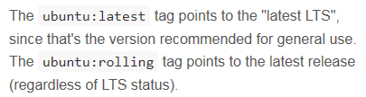
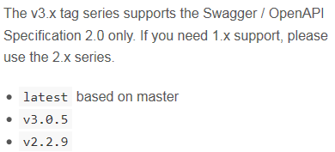
Lesson 2: Meanings of “latest”
“latest LTS release“
“nightly“
ubuntu:latest
vs.
swaggerapi/swagger-ui:latest
https://hub.docker.com/_/ubuntu/
https://hub.docker.com/r/swaggerapi/swagger-ui/
Docker images are not automatically tagged with “latest“
“latest” has no common meaning across projects on Docker Hub
“latest” is assumed if no explicit version is provided
My personal preference: Use “latest“ as “stable release”
Use a $VERSION variable in Docker-Compose-files
Automatically produce docker-compose files with explicit versions
Keep Maven POM version == Docker version tag

Slide 17
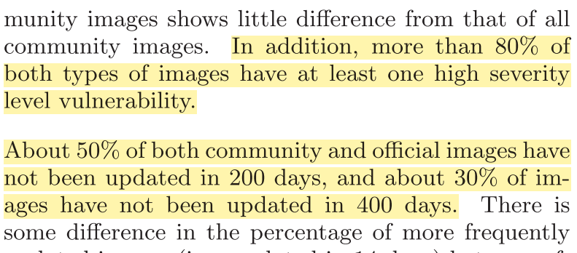
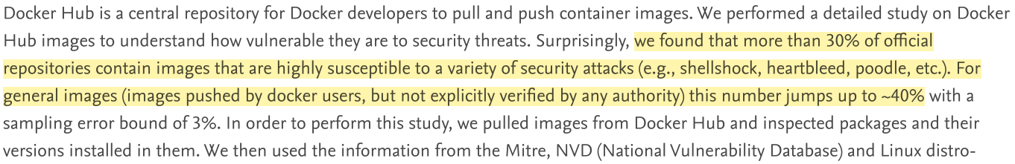
Lesson 3: Docker & Security – it’s complicated
„Docker is a completely new way to ship security flaws!“
- The Internet
Shu, R., Gu, X., & Enck, W. (2017). A Study of Security Vulnerabilities on Docker Hub. In Proceedings of the Seventh ACM on Conference on Data and Application Security and Privacy - CODASPY ’17 (pp. 269–280). https://doi.org/10.1145/3029806.3029832
Gummaraju, J., Desikan, T., & Turner, Y. (2015). Over 30% of Official Images in Docker Hub Contain High Priority Security Vulnerabilities. Https://Banyanops.Com, (May), 1–6. Retrieved from https://banyanops.com/blog/analyzing-docker-hub/

Slide 18
Lesson 3: Docker & Security – it’s complicated
Does this comply to BMWi’s Merkblatt f. die Behandlung von VS-NfD?
With the base image concept, large amounts of binaries are pulled and executed automatically from the internet
The Docker daemon has root-level permissions and communicates directly with the host OS kernel
Attack vector syscalls – can SELinux, S-Virt, Seccomp, … help?
What we can do:
Have a local custom registry with approved base images
Install update for software within the Docker images -> regularly rebuild all layers without using the cache
IBM, Xen, Huawei: Virtual Machines
More about this in: Lesson 7: Use Build Infrastructure

Slide 19
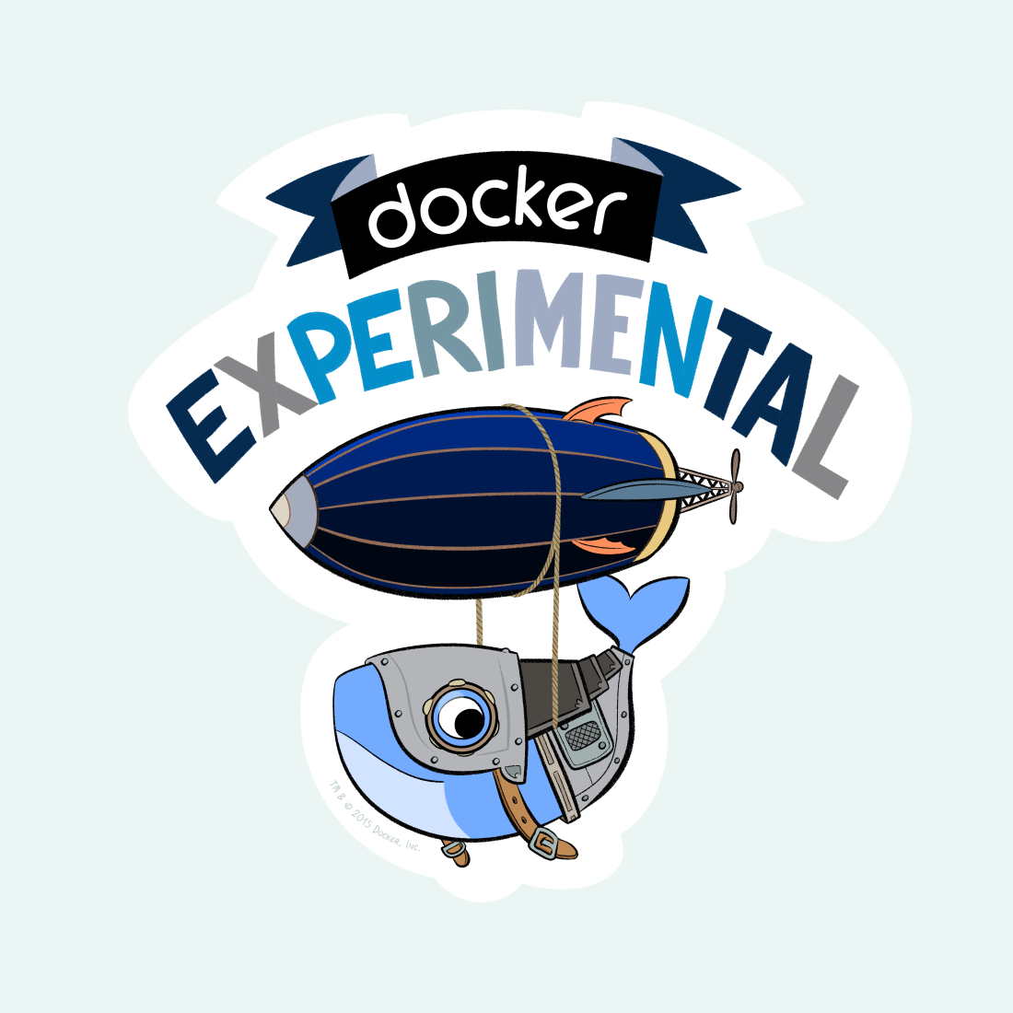
Lesson 4: Docker is not done yet
Docker is under heavy development
#1 information source: GitHub issue tracker
Docker is not trivial, requires cross-technology knowledge
Missing features (such as: management of dangling volumes, no data volume management)
Missing concepts (such as: runtime dependency between containers and large data assets)
Painful use of Docker on Windows 7
Non-native Docker engine
Windows Shell / Linux Bash dichotomy
but Windows 10 is not VS-NfD-ready yet...

Slide 20

Lesson 5: Have a Docker-ready software architecture
“Post box” pattern
Workers can scale
Web page title
http://www.url.com
Message Queue
My Worker
Upload
My Worker
Web page title
My Worker
http://www.url.com
My Worker
Complexity hidden from the user
Job queue is flexible enough and never forgets

Slide 21




Lesson 5: Have a Docker-ready software architecture
Dynamic Web Content Assembly / „Chatty Architecture“
Web page title
Orchestrator
http://www.url.com
My Service 2
4
My Service 1
API Gateway
My Service 3
Services deliver complete page fragments, e.g. via Edge Side Includes
My Service 3
My Service 3
Orchestrator-aware API Gateway routes and scales automatically
Notes:
z.B. traefik

Slide 22



Lesson 5: Have a Docker-ready software architecture
“Post box” pattern
Dynamic Web Content Assembly / „Chatty Architecture“
Web page title
Web page title
Orchestrator
http://www.url.com
http://www.url.com
Upload
Message Queue
My Worker
My Service 2
4
My Service 1
Web page title
My Worker
API Gateway
My Service 3
http://www.url.com
My Worker
My Service 3
My Worker
My Service 3
Design the scalability of your application alongside Docker’s capabilities
Beware of a cargo cult: Docker is not a “lift and shift” technology!
Porting monolithic / legacy / GUI applications might not be feasible
However: Scalability is not the only reason to use Docker
A fully documented software stack as code
Being able to package, rollout and execute

Slide 23
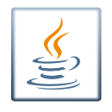


Well this is also possible…
Using a Windows-Java-native DLL and Windows application in Docker
Docker Image (Ubuntu)
Wine
Java.exe
EA.dll
EA.exe
JAR
Certainly not best practice
Docker Engine

Slide 24

… or this…
Using a Windows-Java-native DLL and Windows GUI application in Docker
Docker Image (Ubuntu)
VNC Server
Wine
Java.exe
EA.dll
EA.exe
JAR
Certainly not best practice
Docker Engine

Slide 25

Lesson 6: Docker the MVP-Enabler
Backend Version 1
Backend Version 2
MVP
Backend
API Definition
GUI Demo
Another
GUI Demo
MVP
GUI
t
Docker is a nice contribution to the ecosystem for MVPs and Rapid Prototyping
Contract first
Generate backend and frontend stubs
Package in Docker
Let the backend evolve
Throw-away demos for customer feature demonstrations
Thanks to Docker, all demos are kept available, infrastructure might change entirely
e.g. with tools like Swagger
Java Code Gen produces JAX-RS compliant stub
Maven plugin detects JAX-RS, builds Docker image

Slide 26
Lesson 7: Use Build Infrastructure
Things developers don’t want to do:
Things developers want to do:
Developers are not payed for:
Developers are payed for:
Developing software
Re-inventing the wheel
Configure IDE
Manage and download dependencies
Package software
Execute unit tests and integration tests
Distributing software packages
Continuously monitor source control, build
Determine the common build status (“Are we green?”)
Document operational environment
Install, configure and start-up operational environment
Install, configure and start-up runtime dependency software such as Databases
Prepare, package, configure, distribute and install releases
Commodities
Build Management
Continuous Integration
Build Infrastructure helps automating this
Containers
Continuous Delivery

Slide 27
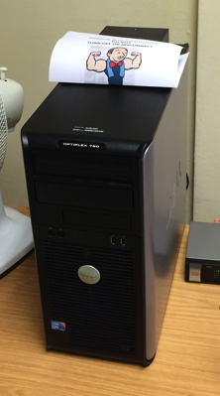
Lesson 7: Use Build Infrastructure
Jenkins, GitLab Pipelines, etc…
Use Build infrastructure to
Continuously build Docker images
Do the testing, indicate results
Push images / roll-out
Launch complete software stack
Overnight complete rebuild of all layers
Automation means: standardisation of build and deployment processes
Notes:
Daily stand up
Standardisierender Faktor
(“Works for me” vs. “Are we green?”)

Slide 28



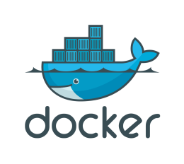
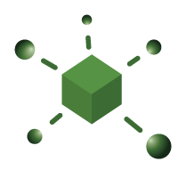
Lesson 8: Streamline Developer’s Workflow
„Oh look it is working!“
Microsoft Windows [Version 7.1.7000]
Copyright (c) 2008 Microsoft Corporation. All rights reserved.
C:\Users\UserName>
Developer
triggers
e.g. Web-Based Application
e.g. Distributed Calculation
commit
Notify on test failure
bring online
update for specific tag
Jenkins
Tag specific
version
push tag
checkout
test
package
push
new version
GitLab
commit new pom.xml
push
Nexus
JAR

Slide 29
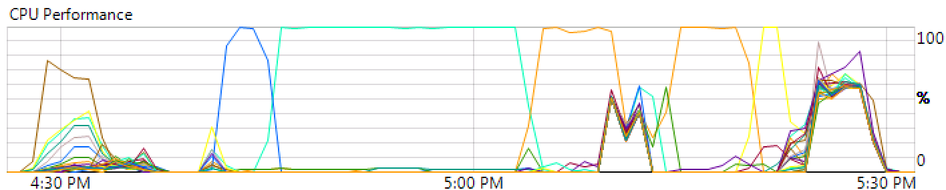
Lesson 9: Rethink Infrastructure
Single-threaded
bottlenecks
My App
My App
Docker Engine
Docker Engine
Incomplete Docker-migration
Ubuntu Host
Ubuntu Host
Micro management
of resources
16 CPUs
16 CPUs
64 GB RAM
64 GB RAM
XenServer

Slide 30
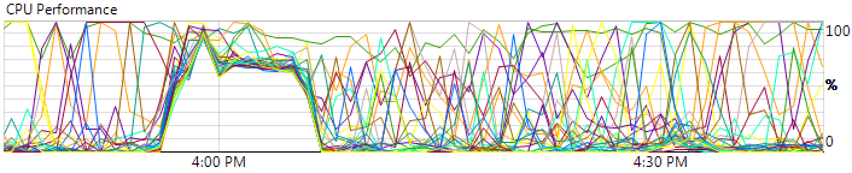
Lesson 9: Rethink Infrastructure
More efficient use of
(rented) resources
My App
My App
My App
My App
Scale on demand
Job Data
Common persistent
Job data storage
Docker Engine
Ubuntu Host
All
resources
are available to Docker
32 CPUs
128 GB RAM
XenServer

Slide 31
Lesson 9: Rethink Infrastructure
Debugging production in 3 simple steps
My App
My App
My App
My App
My App
2. Init debug instance
Job Data
Job Data
3. Re-execute failed commands in production-like environment
Docker Engine
Ubuntu Host
Ubuntu Host
32 CPUs
1. Connect to host
via SSH
128 GB RAM
XenServer

Slide 32
Lesson 10: Refactor mind sets
“Machines should work, Humans should think”
Architectural changes, building and shipping is daily business
Promote use of standard tools over custom solutions
Promote a culture of documentation
The one who deploys (or tells systems to do so) defines the rules for collaboration
Tech. project management / “Operations person” / everybody does DevOps?
“Cool technology” vs. young computer science graduates
Technological product roadmap is impacted by the level of knowledge of graduates in the field
Two main enemies: fears & secrets
New Role?

Slide 33
Lessons learned from two years of Docker
Lesson 1: Understand the tools you use
Lesson 2: Meanings of “latest”
Lesson 3: Docker & Security – it’s complicated
Lesson 4: Docker is not done yet
Lesson 5: Have a Docker-ready architecture
Lesson 6: Docker, the MVP enabler
Lesson 7: Use Build Infrastructure
Lesson 8: Streamline Developer’s Workflow
Lesson 9: Rethink Infrastructure
Lesson 10: Refactor mind sets
Docker Basics
Software- Architecture
Processes
Infrastructure
Mindsets

Slide 34
Interesting readings and tools
Must-read: Docker Best Practices
https://docs.docker.com/engine/userguide/eng-image/dockerfile_best-practices/
Advanced: Good container practices
https://l0rd.github.io/containerspatterns/
Graphical User Interfaces for Docker Engine Management
UI for Docker, Portainer
Docker-Container Auto-Update
Watchtower

Slide 35
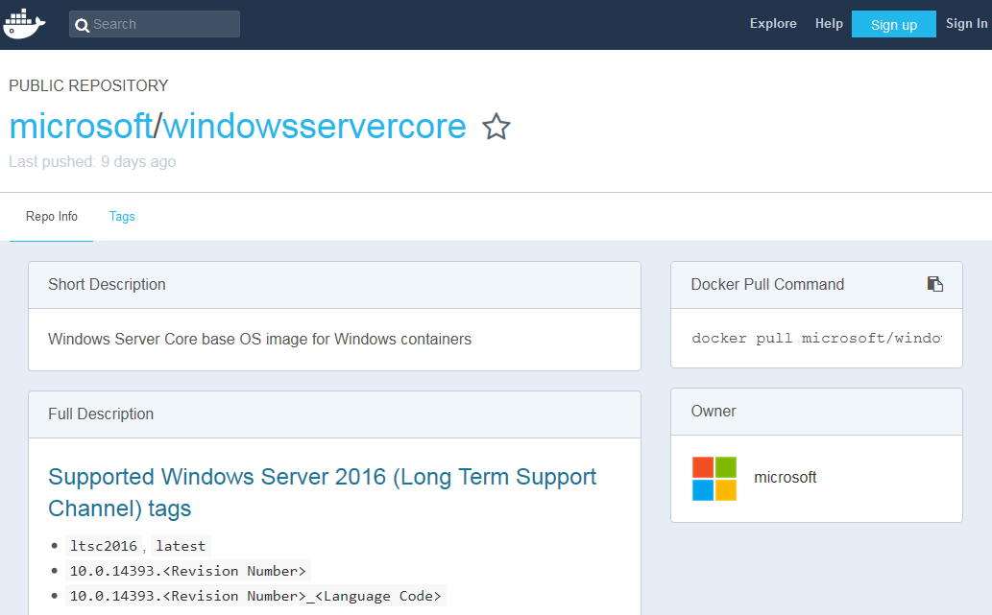
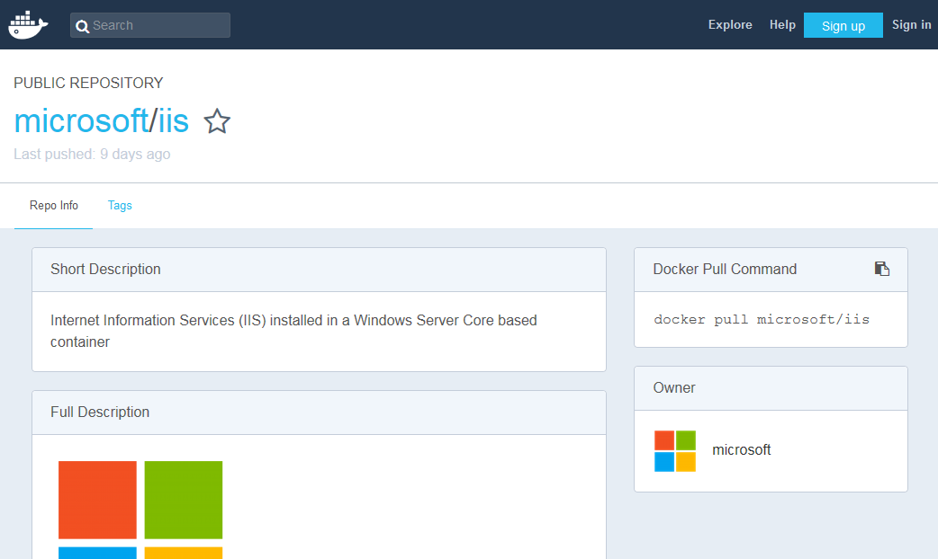
What‘s next: Windows-native Software in Docker
Future versions of Docker: Run Windows-native and Linux-native containers on one Windows host

Slide 36


What‘s next: Streamlined Orchestrator Workflows
for example...
Build ecosystems for the automatic creation of microservices and for debugging them (e.g. fabric8)
Complete toolchain to cover the Plan-Code-Verify-Package-Release-Configure-Monitor lifecycle (e.g. GitLab)

Slide 37
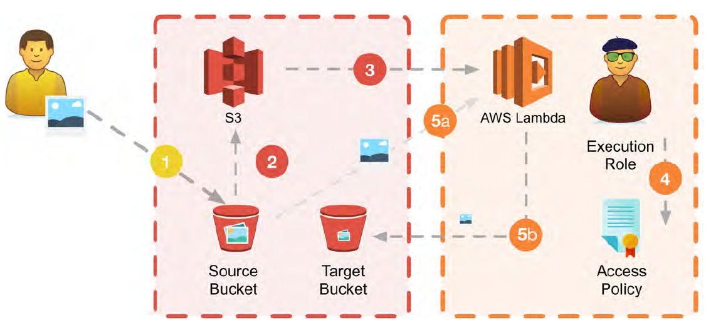
What‘s next: Serverless
Don’t pay idle – “run code, not a server!”
Complex, event-based execution, hard to debug, often highly proprietary
Especially useful when deployables must scale rapidly
Scenarios: Thumbnail creation, Event Streaming, Resource Optimisation, …
Source: W-Jax 2017: Lars Röwekamp – Cloud-Workshop – Vom Cloud-Muffel zum Cloud-Native in sechs Stunden

Slide 38
These slides are available online:
Dr. Timm Heuss
Fraunhofer Institute for Communication, Information Processing and Ergonomics
Fraunhoferstraße 20 53343 Wachtberg
Germany
Timm.Heuss@fkie.fraunhofer.de
+49 228 9435-154
https://github.com/heussd/docker-bwi-innovation-talk
Font Rufscript by Hiran Venugopalan is licenced under the terms of GPL with font exception.

